Slide 1

Introduction to linked lists

Slide 2
Outline
In this lesson, we will:
Describe the idea of a linked list
Describe a simple variation of a linked list that you can implement
Add values to this linked list
Consider some issues and benefits of linked lists

Slide 3
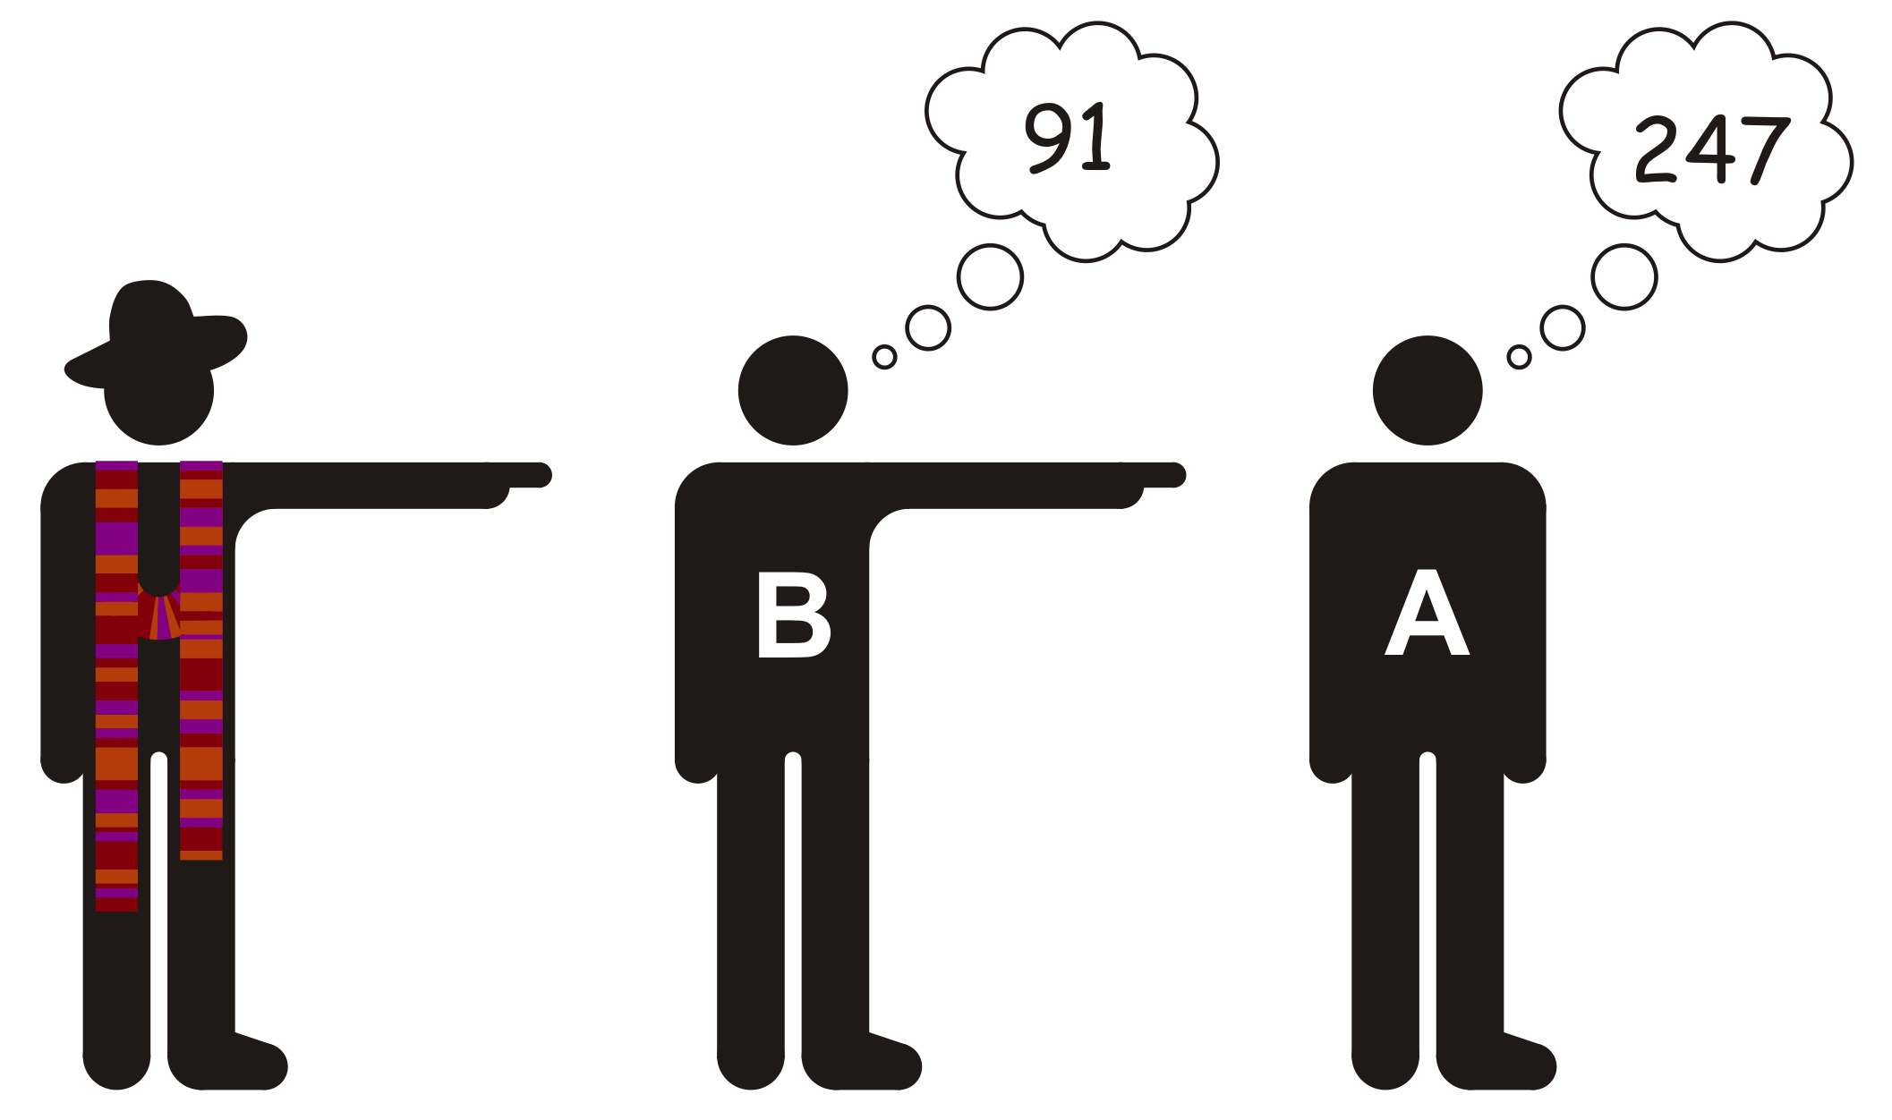
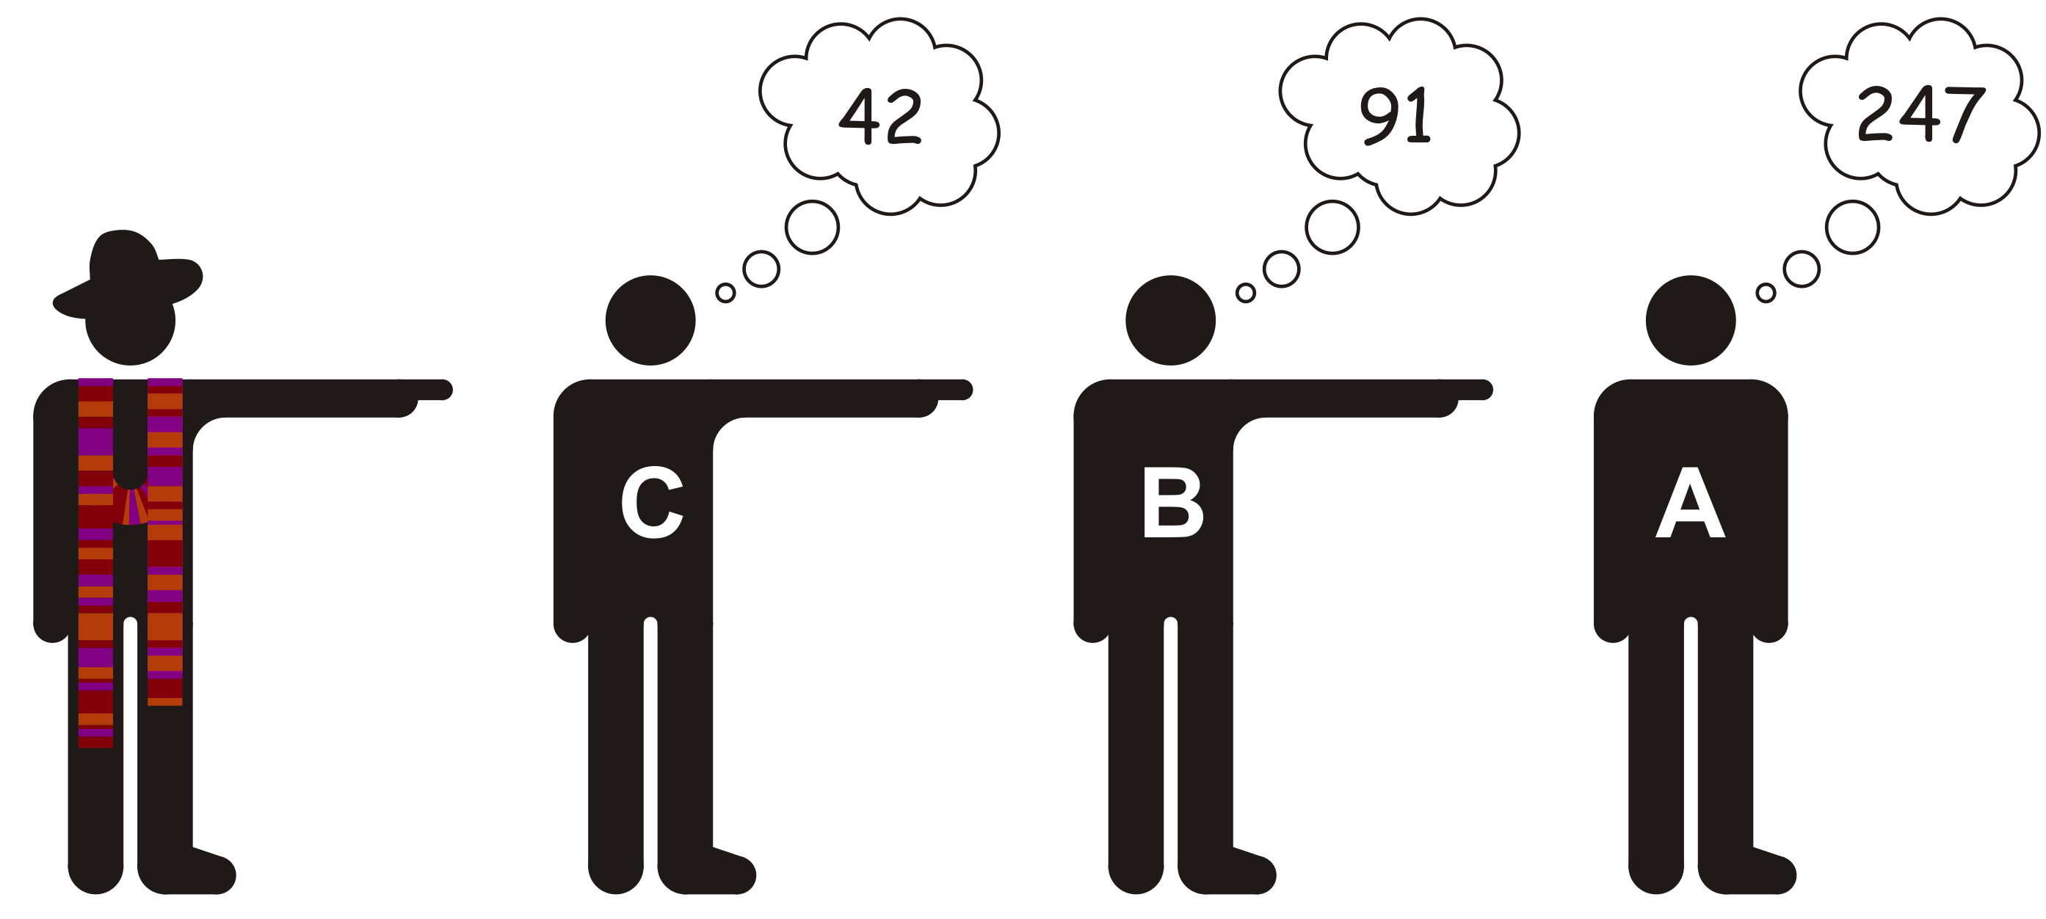
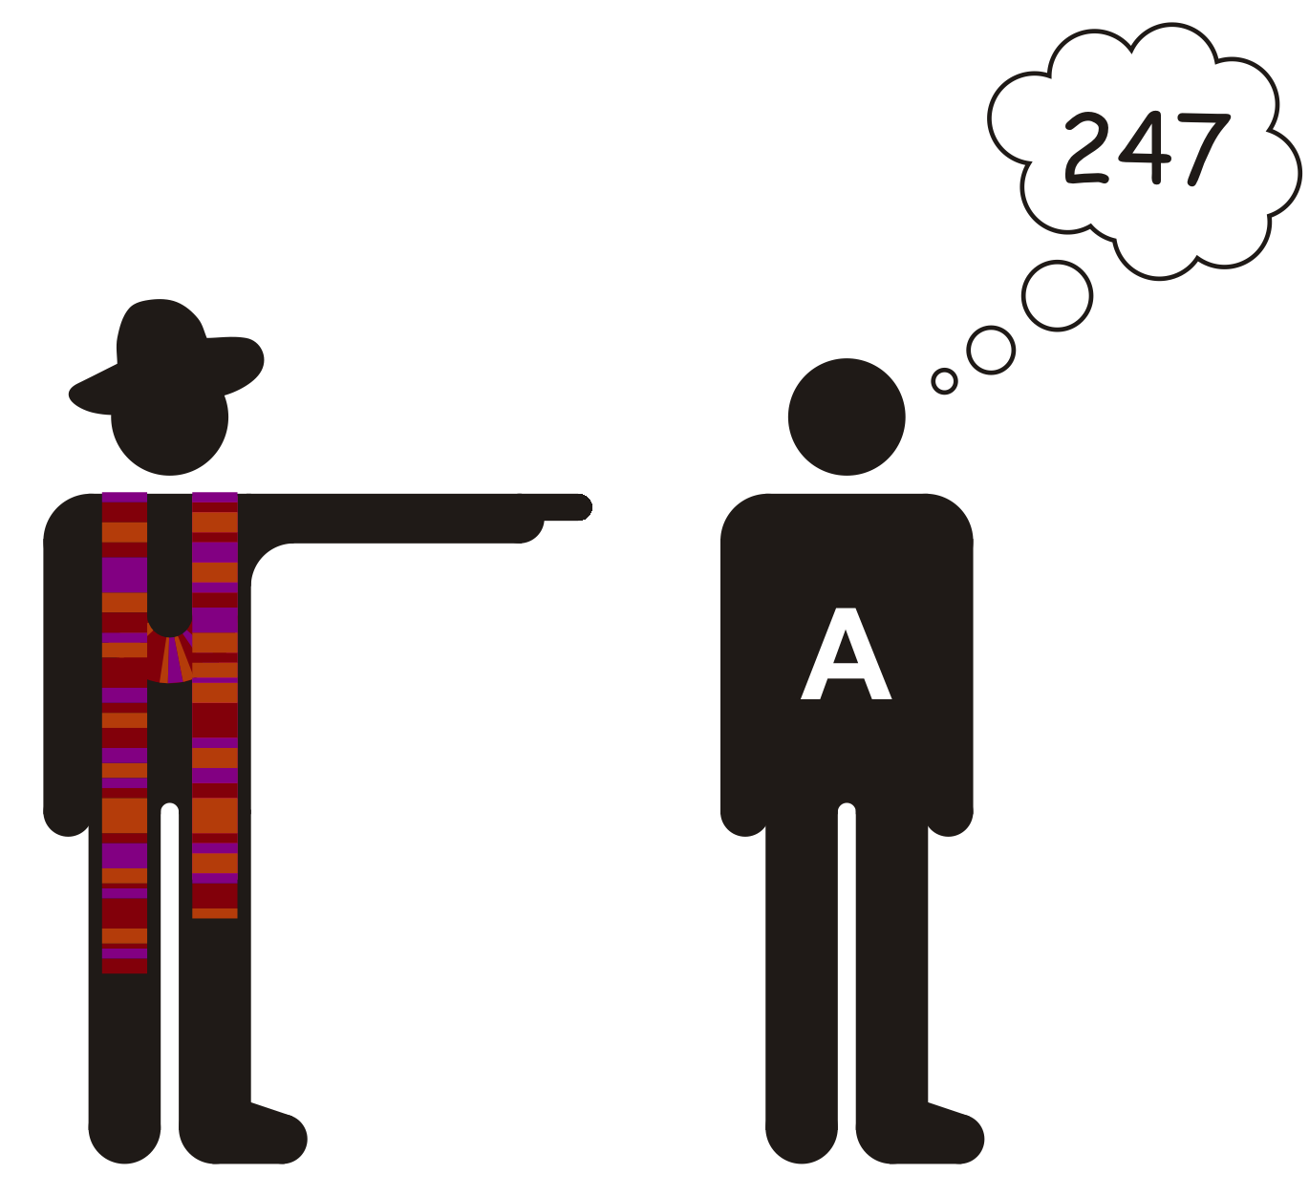


Nodes
Suppose I want to remember some numbers
I could use this class

Slide 4
Nodes
Each student is remembering two pieces of information:
A number
The next student
This sound like a class, and we will call this class a node:
class Node {
public:
double value_;
??? next_;
};

Slide 5
Nodes
Let assume we have an array of these nodes, thus, we could identify each node with an index
class Node {
public:
double value_;
std::size_t next_index_;
};
Thus, we could have the nodes as follows:
std::size_t const list_cap{10};
Node a_nodes[list_cap]{};
for ( std::size_t k{0}; k < list_cap; ++k ) {
a_nodes[k].next_index_ = list_cap + 1; // indicates not used
}
All the program need do is remember the first index
The head of the linked list
std::size_t list_head{ list_cap };

Slide 6
Nodes
Thus, we have:
int main() {
std::size_t const list_cap{10};
Node a_nodes[list_cap]{};
for ( std::size_t k{0}; k < list_cap; ++k ) {
a_nodes[k].next_index_ = list_cap + 1;
}
std::size_t list_head{ list_cap };
// Let us use this linked list
return 0;
}

Slide 7
Nodes
Without coding, let’s see what we’d like to do:
Here is our initial set-up:
10 | list_head
0 | 1 | 2 | 3 | 4 | 5 | 6 | 7 | 8 | 9
0.0 | 0.0 | 0.0 | 0.0 | 0.0 | 0.0 | 0.0 | 0.0 | 0.0 | 0.0
11 | 11 | 11 | 11 | 11 | 11 | 11 | 11 | 11 | 11
value_
next_index_

Slide 8
Nodes
Without coding, let’s see what we’d like to do:
To add 4.2, we
Find an unused node
Set the value and its next index to 10 to indicate it is the last node
Remember that index
5
10 | list_head
0 | 1 | 2 | 3 | 4 | 5 | 6 | 7 | 8 | 9
0.0 | 0.0 | 0.0 | 0.0 | 0.0 | 0.0 | 0.0 | 0.0 | 0.0 | 0.0
11 | 11 | 11 | 11 | 11 | 11 | 11 | 11 | 11 | 11
value_
4.2
10
next_index_

Slide 9
Nodes
Without coding, let’s see what we’d like to do:
To add 9.1, we
Find an unused node
Set the value and its next index to 5
Remember that index
2
5 | list_head
0 | 1 | 2 | 3 | 4 | 5 | 6 | 7 | 8 | 9
0.0 | 0.0 | 0.0 | 0.0 | 0.0 | 4.2 | 0.0 | 0.0 | 0.0 | 0.0
11 | 11 | 11 | 11 | 11 | 10 | 11 | 11 | 11 | 11
value_
9.1
5
next_index_

Slide 10
Nodes
Without coding, let’s see what we’d like to do:
To add 6.3, we
Find an unused node
Set the value and its next index to 2
Remember that index
7
2 | list_head
0 | 1 | 2 | 3 | 4 | 5 | 6 | 7 | 8 | 9
0.0 | 0.0 | 9.1 | 0.0 | 0.0 | 4.2 | 0.0 | 0.0 | 0.0 | 0.0
11 | 11 | 5 | 11 | 11 | 10 | 11 | 11 | 11 | 11
value_
6.3
2
next_index_

Slide 11
Nodes
We can see why this is called a linked list
7 | list_head
0 | 1 | 2 | 3 | 4 | 5 | 6 | 7 | 8 | 9
0.0 | 0.0 | 9.1 | 0.0 | 0.0 | 4.2 | 0.0 | 6.2 | 0.0 | 0.0
11 | 11 | 5 | 11 | 11 | 10 | 11 | 2 | 11 | 11
value_
next_index_

Slide 12
Nodes
Could we program a walk through this linked list?
std::size_t index{ list_head };
while ( index != list_cap ) {
std::cout << a_nodes[index].value_ << std::endl;
index = a_nodes[index].next_index_;
}
7 | list_head
0 | 1 | 2 | 3 | 4 | 5 | 6 | 7 | 8 | 9
0.0 | 0.0 | 9.1 | 0.0 | 0.0 | 4.2 | 0.0 | 6.2 | 0.0 | 0.0
11 | 11 | 5 | 11 | 11 | 10 | 11 | 2 | 11 | 11
value_
next_index_

Slide 13
Nodes
In fact, this could be a for loop:
for ( std::size_t index{ list_head }; index != list_cap;
index = a_nodes[index].next_index_ ) {
std::cout << a_nodes[index].value_ << std::endl;
}
7 | list_head
0 | 1 | 2 | 3 | 4 | 5 | 6 | 7 | 8 | 9
0.0 | 0.0 | 9.1 | 0.0 | 0.0 | 4.2 | 0.0 | 6.2 | 0.0 | 0.0
11 | 11 | 5 | 11 | 11 | 10 | 11 | 2 | 11 | 11
value_
next_index_

Slide 14
Questions
How would you do the following?
Add a node to the end of the linked list, not the start
Remove the first node from the linked list
This assumes there is at least one node in that linked list
Remove the last node from the linked list
What happens if there is only one node in the linked list?
Remove an arbitrary node in the linked list?
What would you do to a removed node to ensure it can be reused?

Slide 15
Question
What happens if we accidentally execute the following?
if ( list_head = 0 ) {
std::cout << "We are at the array[0]" << std::endl;
}
0
7 | list_head
0 | 1 | 2 | 3 | 4 | 5 | 6 | 7 | 8 | 9
0.0 | 0.0 | 9.1 | 0.0 | 0.0 | 4.2 | 0.0 | 6.2 | 0.0 | 0.0
11 | 11 | 5 | 11 | 11 | 10 | 11 | 2 | 11 | 11
value_
next_index_

Slide 16
Issue
Once again, we are restricted to the capacity of our array
Would it not be better to get each node from the operating system?
Benefit: as long as there is memory available, we can continue to build our linked list
Drawback: asking for new memory is actually sort-of slow… ☹

Slide 17
Summary
Following this lesson, you now
Understand the idea of a node within a linked list
Know that it is only necessary to store the first index
Know that each node stores the index of the next node
Understand how you can add additional nodes to this linked list
Have a few questions to work out before your next lecture
Know that there are problems with the current design

Slide 18
References
[1] https://en.wikipedia.org/wiki/Linked_list
[2] https://en.wikipedia.org/wiki/Node_(computer_science)

Slide 19



Colophon
These slides were prepared using the Georgia typeface. Mathematical equations use Times New Roman, and source code is presented using Consolas.
The photographs of lilacs in bloom appearing on the title slide and accenting the top of each other slide were taken at the Royal Botanical Gardens on May 27, 2018 by Douglas Wilhelm Harder. Please see
https://www.rbg.ca/
for more information.

Slide 20
Disclaimer
These slides are provided for the ece 150 Fundamentals of Programming course taught at the University of Waterloo. The material in it reflects the authors’ best judgment in light of the information available to them at the time of preparation. Any reliance on these course slides by any party for any other purpose are the responsibility of such parties. The authors accept no responsibility for damages, if any, suffered by any party as a result of decisions made or actions based on these course slides for any other purpose than that for which it was intended.

